Slide 1
Statistics and Reliability: Module 4
Statistical Process Control (SPC)
Notes:
Module Topics
Objectives and benefits
Rational subgrouping
Selection and application of control charts
Analysis of control charts
Copyright (c) Deere & Company, as an unpublished work. This material is the property of Deere & Company. All use, disclosure, and/or reproduction not specifically authorized by Deere & Company is prohibited.

Slide 2
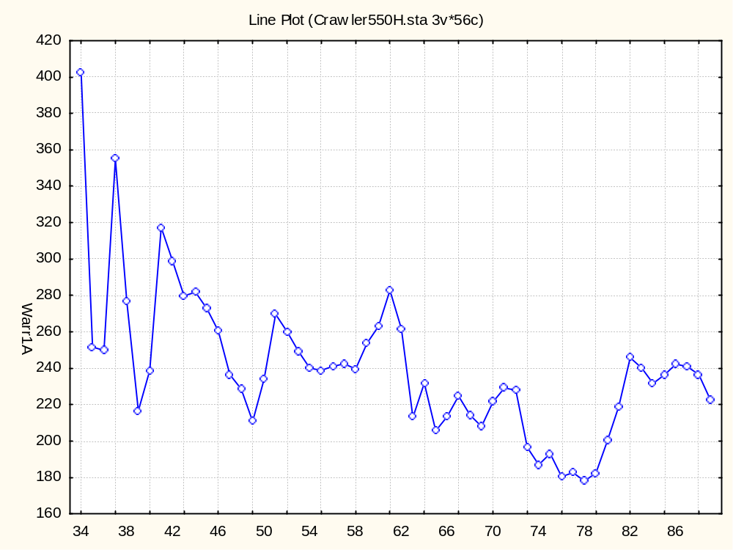
Notes:
Run Charts (2D Line Plots in Statistica)
What: A visual representation of time series data; a plot of data over time
Why: To monitor a process to see whether or not the long range average is changing
When: You need to do a simple display of observations to determine whether there is a trend over a specified time period
How:
Put measurement being studied on the vertical axis (y-axis) of the graph
Put time metric on the horizontal axis (x-axis) of the graph
Plot data in order that is was gathered
Time sequence of data points is critical
Optional:
Connect data points for easy identification of sequence and interpretation
Draw a straight line across the plot at the average value of the measurements
Run charts are the first step for creating a control chart.

Slide 3
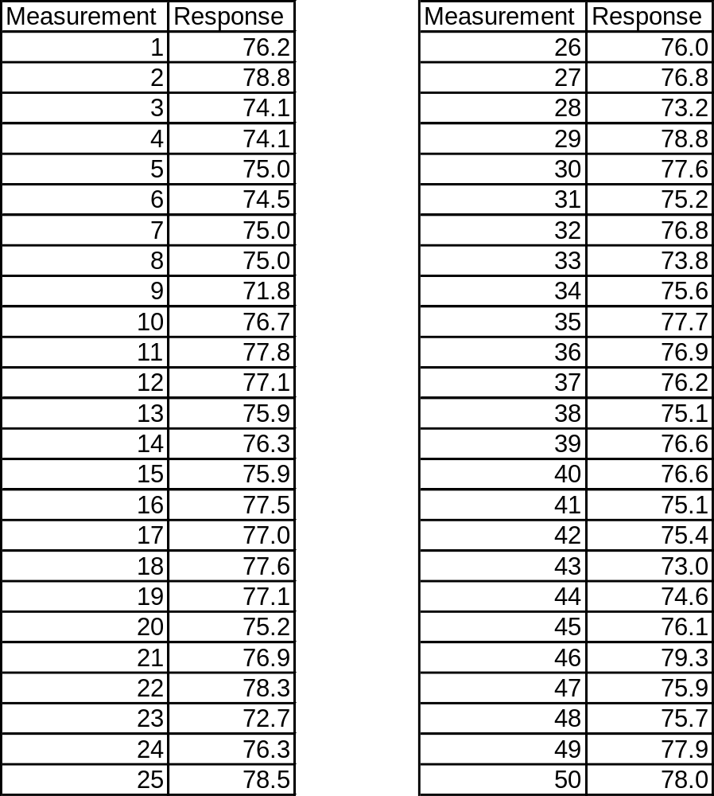
3.4 Example 3.1: Reacting to Data
Notes:
Data from page 76.
The product has specification limits of 72-78.

Slide 4
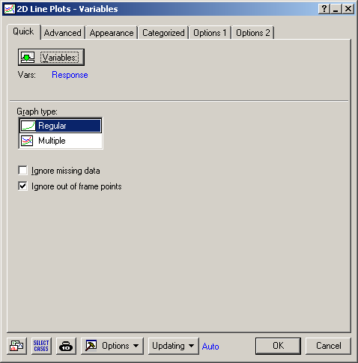
Notes:
Graphs > 2D Graphs > Line Plots (Variables)
Select the “Graphs” menu.
Select the “2D Graphs” option.
Select the “Line Plots (Variables)” sub-option.
Select “Variables” and then enter “Response” and click “OK”.
Note the Case Names are the Measurement number; otherwise Statistica will print “Case 1”, “Case 2”, “Case 3”, etc. on the X-axis (which is rather annoying). To do this, select the “Cases” button on the data view, select “Case Names Manager...”, and enter “Measurement” in the “Transfer case names” variable field.

Slide 5
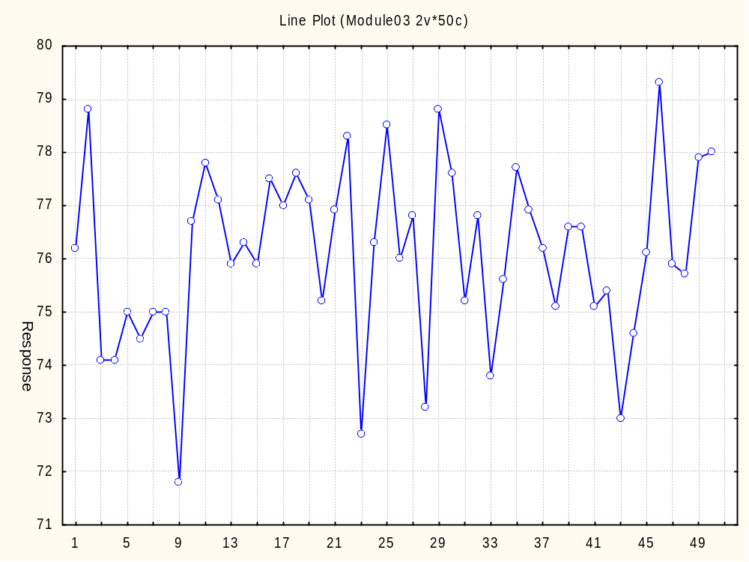
Notes:
Compare to FIGURE 3.2 Reacting to common-cause data as though it were special cause.
Since the product has specification limits of 72-78, these lines were manually superimposed on the plot – but do not ever confuse them with control limits!

Slide 6
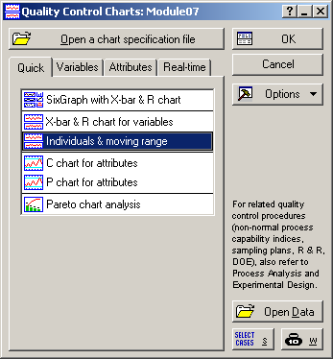
Notes:
Statistics > Industrial Statistics & Six Sigma > Quality Control Charts > Individuals & moving range
Select the “Statistics” menu.
Select the “Industrial Statistics & Six Sigma” option.
Select the “Quality Control Charts” sub-option.
Select “Individuals & moving rage” on the “Quick” tab.

Slide 7
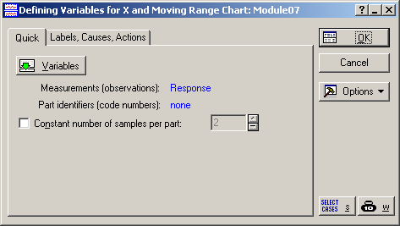
Notes:
Measurements (observations) = Response

Slide 8
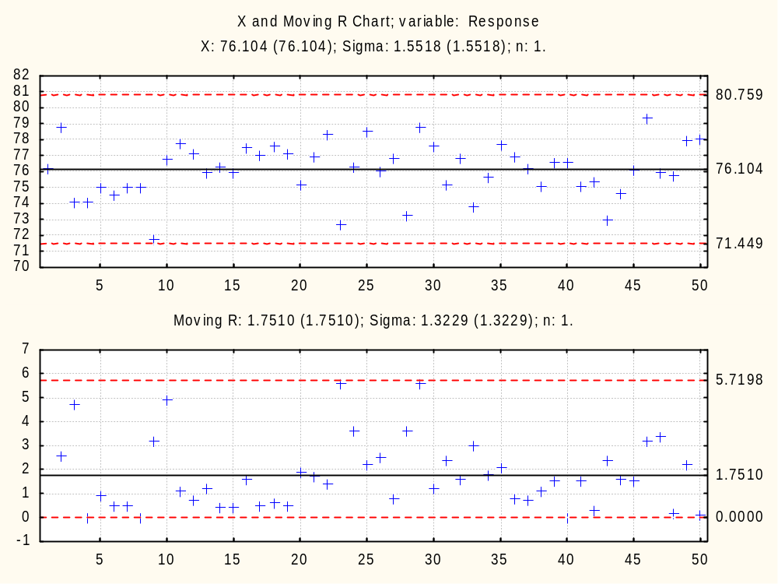
Notes:
Compare to FIGURE 3.3 Control chart showing variability of data to be from common cause.
The numbers for the control limits are slightly different. This might due to more digits used than what were reported in the textbook, but maybe there’s a slight difference between Statistica and Minitab, because this happens elsewhere to.
Note: the default version shows histograms for the Observations and Moving Ranges on the left side. I removed those by going to the “Options” button and unselecting the “Include Histograms” check box and recreating the plots by going to the “Charts” tab and selecting the “X (MA..) & R/S” button.

Slide 9
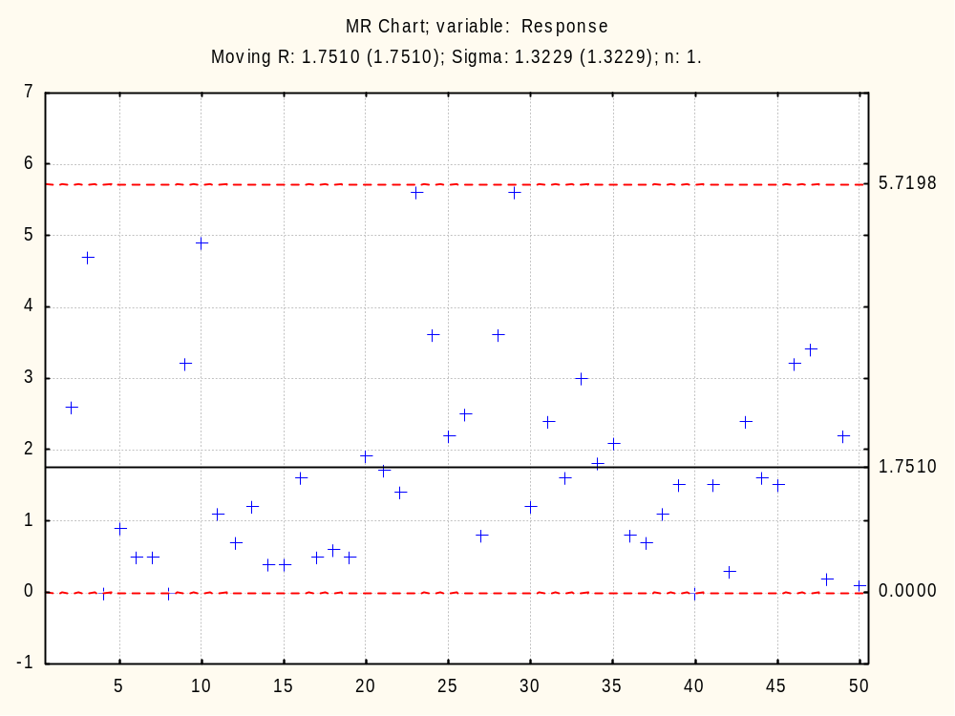
Notes:
Control Charts
What:
A run chart with statistically determined Upper Control Limit (UCL) and Lower Control Limit (LCL) lines drawn on either side of the process average line
Why:
To filter the noise present in a time-series data set in order to minimize the following two mistakes:
interpreting noise (common cause variation) as if it were a signal, i.e., tampering
failing to detect a signal (special cause variation) when it is present
When:
Determine whether or not a process has been operating in statistical control
Achieve and maintain statistical control

Slide 10
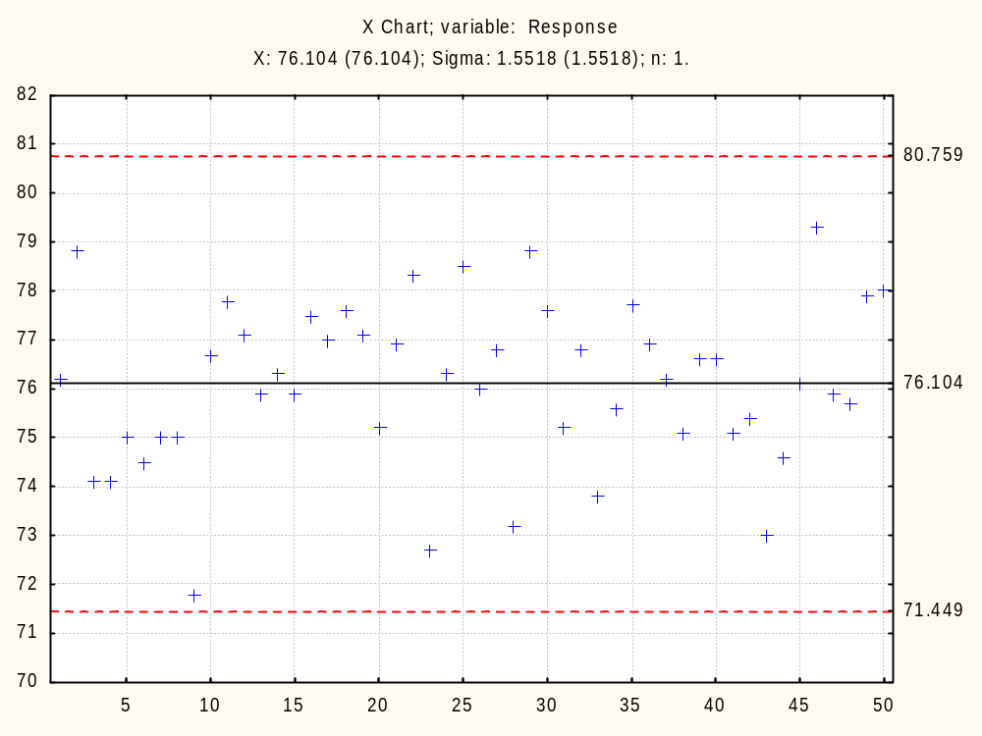
Notes:
How:
Construct a run chart for the range (R) and mean (X) the of the data in appropriate subgroups
If there are no appropriate subgroups, use individual values and moving range
Add process average line and control limits:
UCL_{R} = D4*Mean(R)
LCL_{R} = D3*Mean(R)
UCL_{X} = Mean(X) + 3*Mean(R)/d2
LCL_{X} = Mean(X) - 3*Mean(R)/d2
[See a statistical process control book for the appropriate values of d2, D3 and D4]
Interpret chart - Process is “out of control” if:
One or more points fall outside of the control limits on either the mean chart or the range chart, or
There are non-random patterns of data within the control limits
[See a statistical process control book for more details]

Slide 11
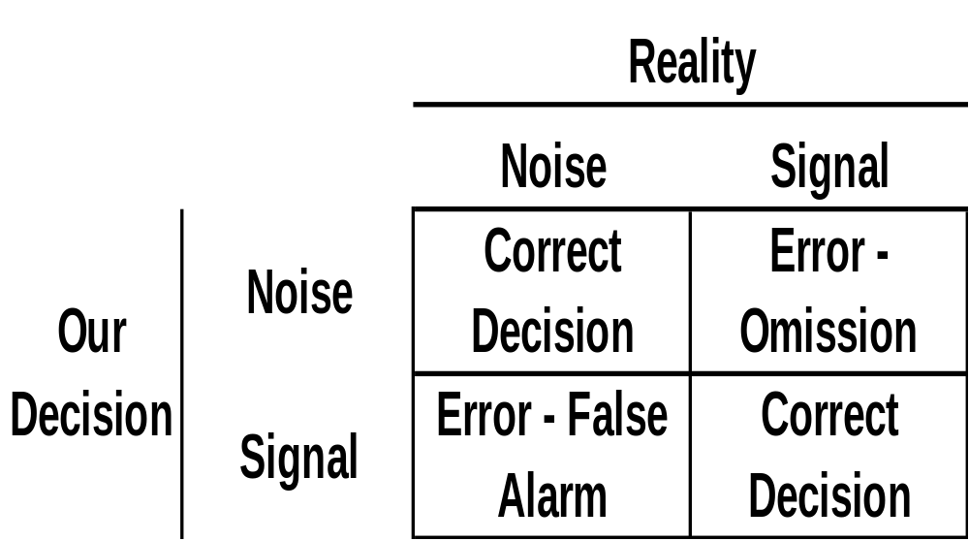
Statistical Process Control
Notes:
Noise = Random variation = Common cause variation
Signal = Something changed = Special cause variation
Unlike a traditional hypothesis tests with an existing population (enumerative study), SPC data comes in the form of a time series, in which the population is continually being created (analytic study), and possibly changing. So traditional methods are not appropriate, though many try to use them to rationalize SPC techniques.

Slide 12
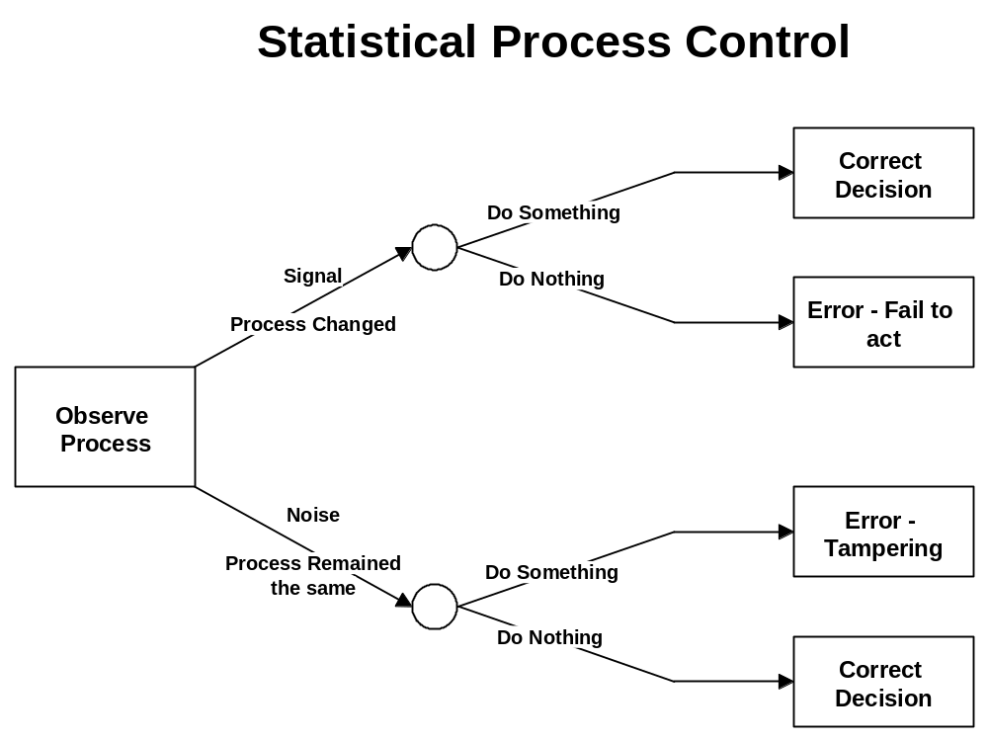
Notes:
Reducing Variation
Eliminate special-cause variation
Find cause and prevent recurrence
Establish statistical control
Reduce common-cause variation
Study the system
Get management involved
Improve the system

Slide 13
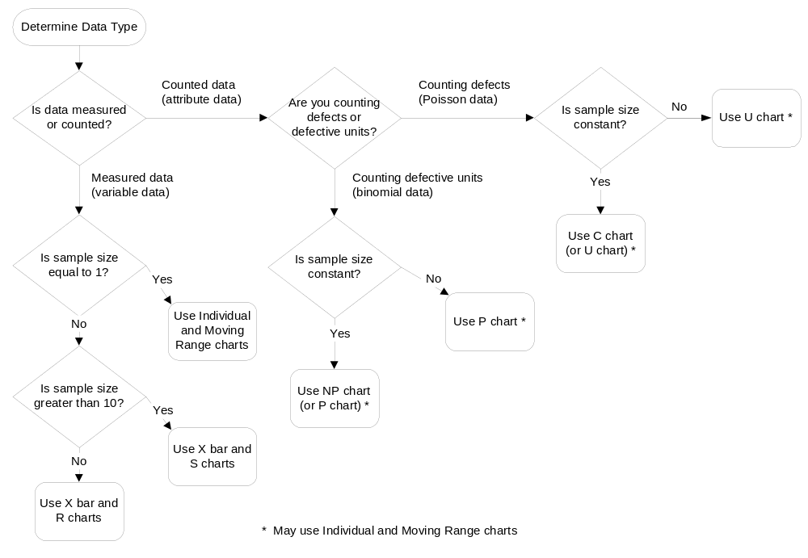
Choosing A Control Chart
Notes:
From Understanding Statistical Process Control, Wheeler & Chambers. First you need to determine the data type, which we covered in the Numbers section. Note that the Individual and Moving Range charts can be used for any situation except when there are “rational subgroups.”
The following is an excerpt from Chapter 4 of The Quality Engineering Handbook by Thomas Pyzdek:
“The basis of all control charts is the rational subgroup. Rational subgroups are composed of items which were produced under essentially the same conditions. The statistics, for example, the average and range, are computed for each subgroup separately, then plotted on the control chart. When possible, rational subgroups are formed by using consecutive units. Each subgroup’s statistics are compared to the control limits, and patterns of variation between subgroups are analyzed. Note the sharp contrast between this approach and the random sampling approach used for enumerative statistical methods.”
http://www.isixsigma.com/offsite.asp?A=Fr&Url=http://www.qualityamerica.com/knowledgecente/articles/CQE_RationalSG.html

Slide 14
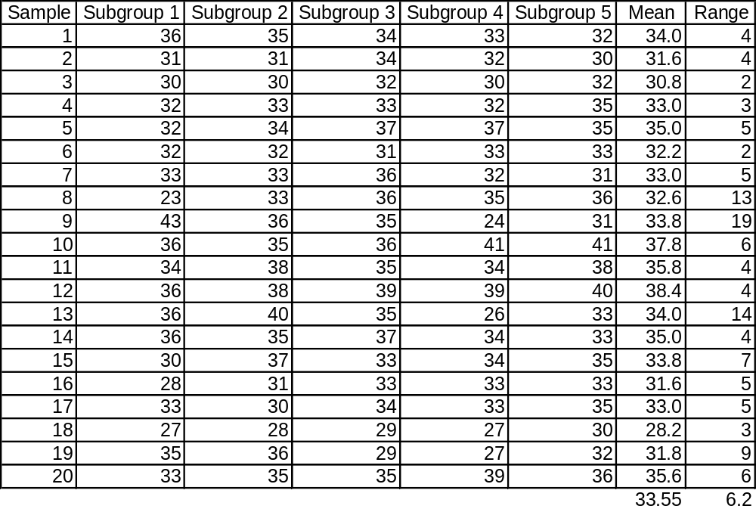
Table 10.1 X-bar and R-Chart Data
Notes:
Page 224: “A grinding machine is to produce threads for a hydraulic system of an aircraft to a diameter of 0.4037 + 0.0013 in.... Measurements were taken every hour on five sample using a visual comparator that had an accuracy of 0.0001... (values are expressed in units of 0.0001 in. in excess of 0.40000 in.)”

Slide 15
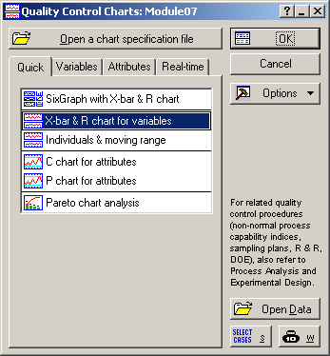
Notes:
Statistics > Industrial Statistics & Six Sigma > Quality Control Charts > X-bar & R chart for variables
Select the “Statistics” menu.
Select the “Industrial Statistics & Six Sigma” option.
Select the “Quality Control Charts” sub-option.
Select “X-bar & R chart for variables” on the “Quick” tab.

Slide 16
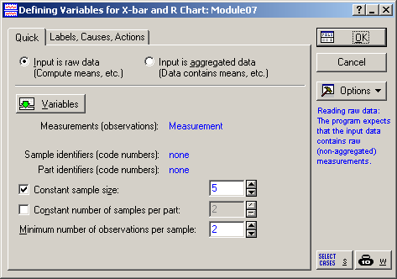
Notes:
Measurement = Measurement
Make sure the Constant sample size = 5. This is the default and the right number for this data set, but it might not be the right number of all data sets.

Slide 17
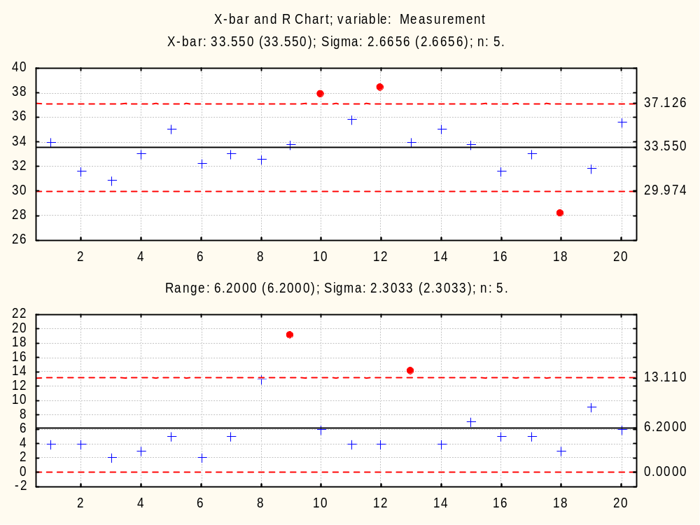
Notes:
Compare to FIGURE 10.9 X-bar and R control chart example.
Page 225: “Both the x-bar (points 10, 12, and 18) and R (points 9 and 13) charts show lack of control. These points should have an assignable cause for being outside the control limits.”

Slide 18
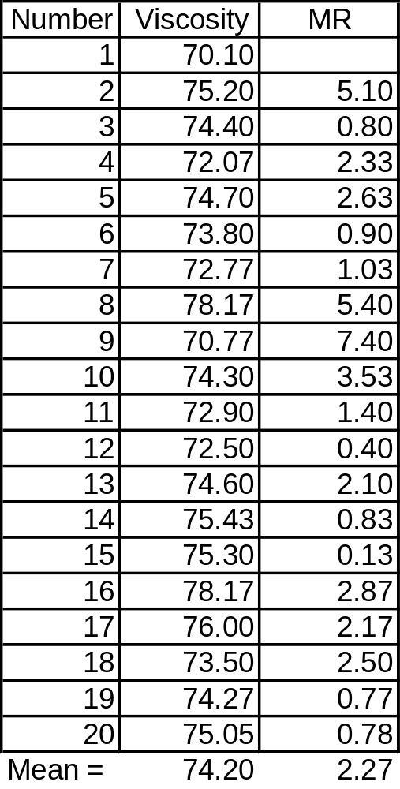
Table 10.2 XmR Chart Data
Notes:
Pages 227 and 228: “The viscosity of a chemical mixing process has the centipoise (cP) measurements noted in Table 10.2 for 20 batches.”

Slide 19
Notes:
Statistics > Industrial Statistics & Six Sigma > Quality Control Charts > Individuals & moving range
Select the “Statistics” menu.
Select the “Industrial Statistics & Six Sigma” option.
Select the “Quality Control Charts” sub-option.
Select “Individuals & moving rage” on the “Quick” tab.

Slide 20

Notes:
Measurements (observations) = Viscosity

Slide 21
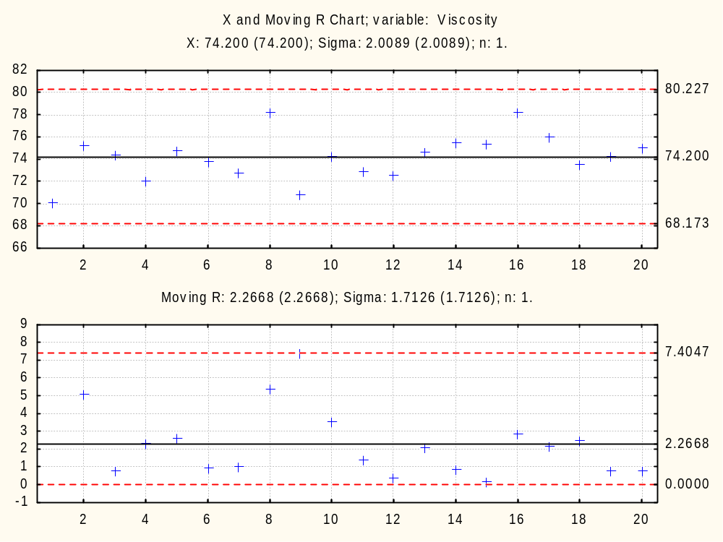
Notes:
Compare to FIGURE 10.10 XmR control chart example.
Page 229: “The XmR computer plots shown in Figure 10.10 indicate no out-of-control condition for these data (i.e., a predictable process).”

Slide 22
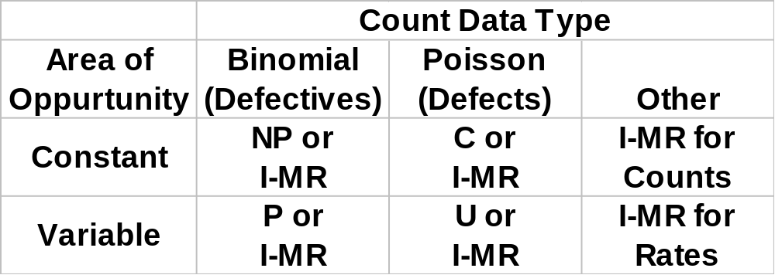
Attribute Control Chart Summary
Notes:
From Understanding Statistical Process Control, Wheeler & Chambers.
This table shows that I-MR charts can be used for attribute control charts.

Slide 23
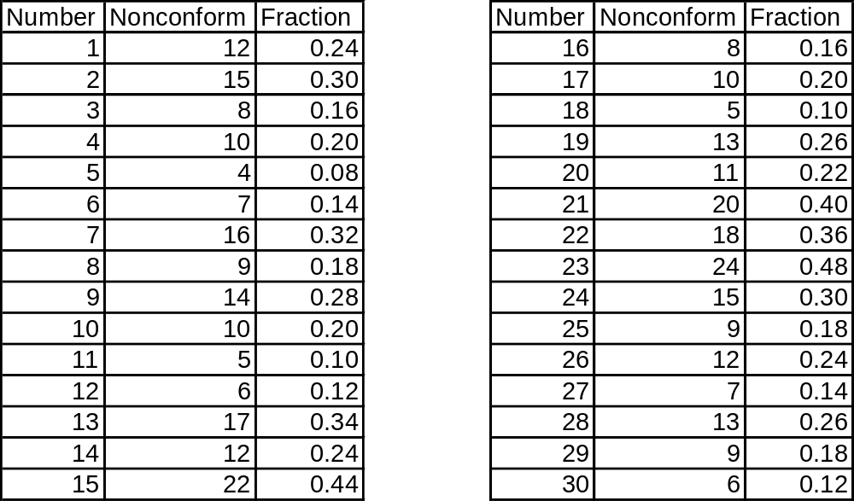
Table 10.3 Data for p-Chart Example
Notes:
Page 232: “A machine manufactures cardboard cans used to package frozen orange juice. Cans are then inspected to determine whether they will leak when filled with orange juice. A p chart is initially established by taking 30 samples of 50 cans at half-hour intervals within the manufacturing process...”
Faction = Nonconform/50

Slide 24
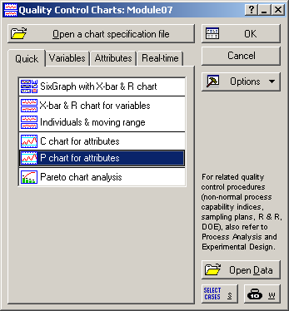
Notes:
Statistics > Industrial Statistics & Six Sigma > Quality Control Charts > P chart for attributes
Select the “Statistics” menu.
Select the “Industrial Statistics & Six Sigma” option.
Select the “Quality Control Charts” sub-option.
Select “P chart for attributes” on the “Quick” tab.

Slide 25
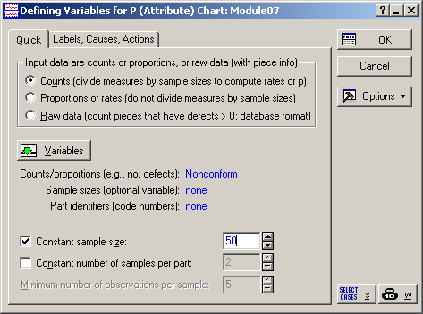
Notes:
Counts/proportions = Noncomform
Constant sample size = 50

Slide 26
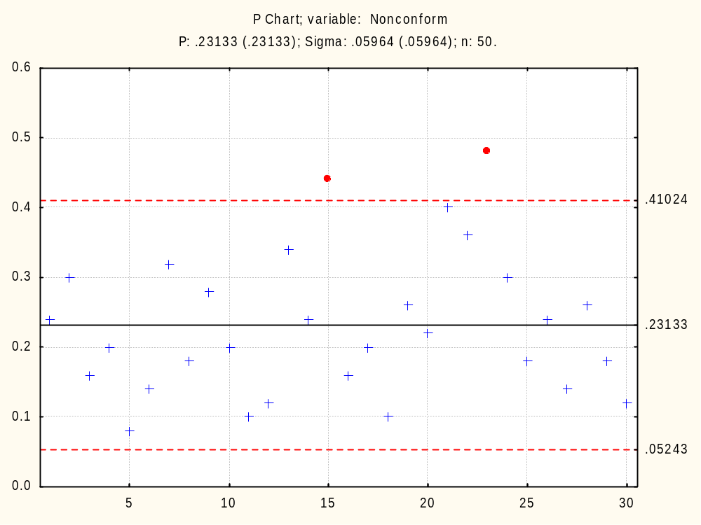
Notes:
Compare to FIGURE 10.11 p-Chart example.

Slide 27
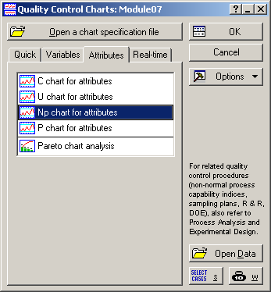
Notes:
Statistics > Industrial Statistics & Six Sigma > Quality Control Charts > Np chart for attributes
Select the “Statistics” menu.
Select the “Industrial Statistics & Six Sigma” option.
Select the “Quality Control Charts” sub-option.
Select “Np chart for attributes” on the “Attributes” tab.

Slide 28

Notes:
Counts/proportions = Noncomform
Constant sample size = 50
Same as p-Chart.

Slide 29
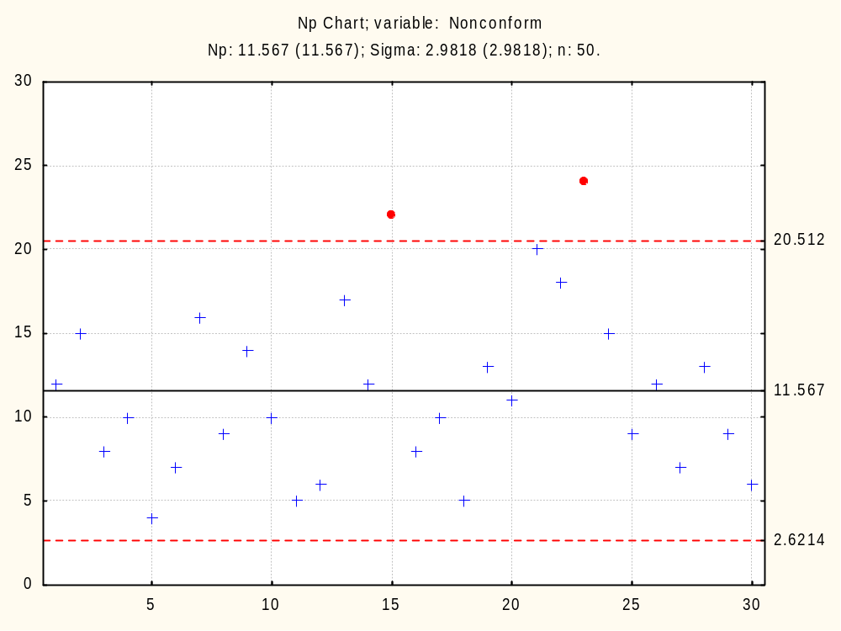
Notes:
Compare to the p Chart on Slide 26.

Slide 30
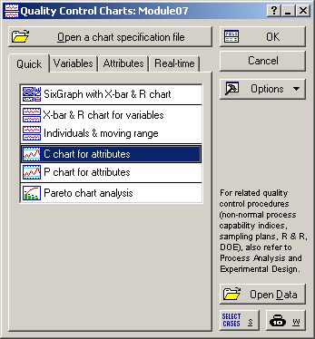
Notes:
Statistics > Industrial Statistics & Six Sigma > Quality Control Charts > C chart for attributes
Select the “Statistics” menu.
Select the “Industrial Statistics & Six Sigma” option.
Select the “Quality Control Charts” sub-option.
Select “C chart for attributes” on the “Quick” tab.

Slide 31
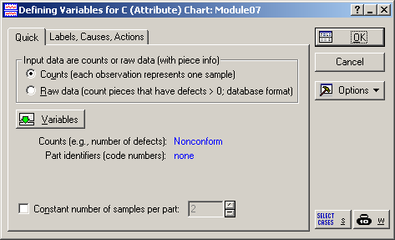
Notes:
Counts = Nonconform

Slide 32
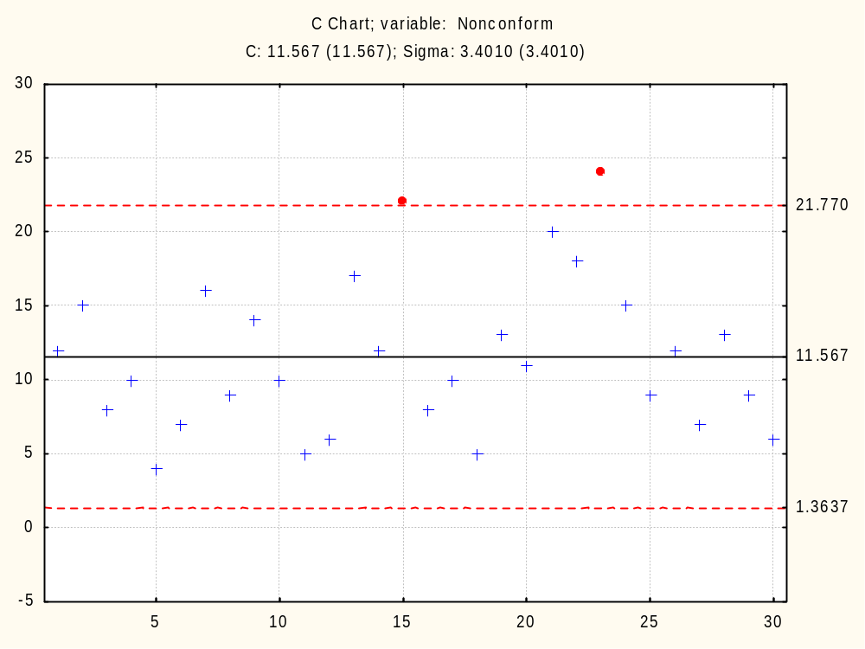
Notes:
Compare to the p Chart on Slide 26 and the Np Chart on Slide 29.

Slide 33
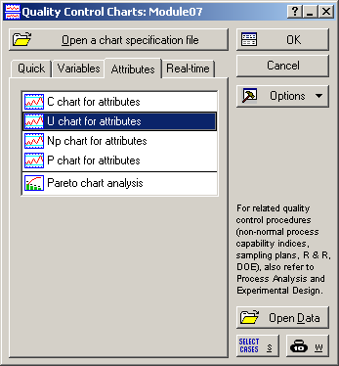
Notes:
Statistics > Industrial Statistics & Six Sigma > Quality Control Charts > U chart for attributes
Select the “Statistics” menu.
Select the “Industrial Statistics & Six Sigma” option.
Select the “Quality Control Charts” sub-option.
Select “U chart for attributes” on the “Attributes” tab.

Slide 34

Notes:
Counts/proportions = Nonconform
Cost sample size = 50

Slide 35
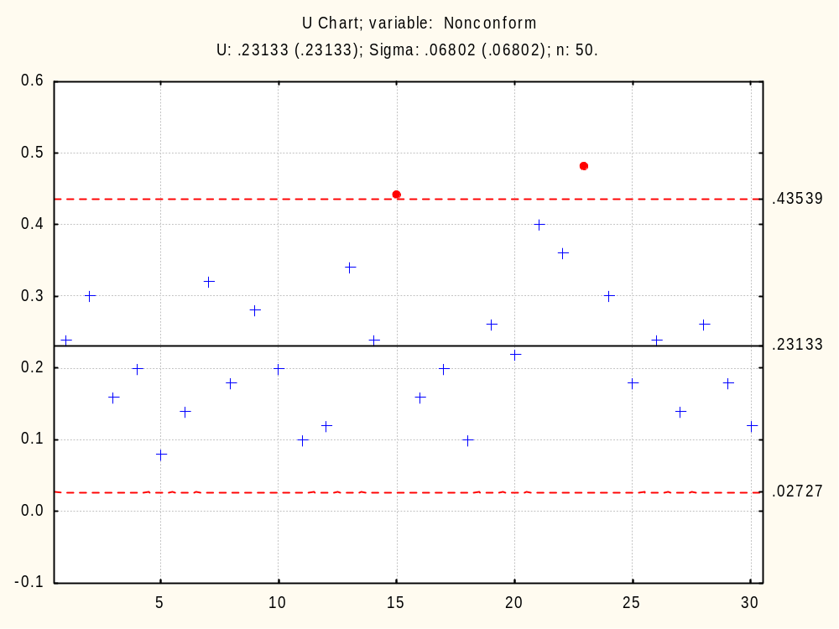
Notes:
Compare to the p Chart on Slide 26, the Np Chart on Slide 29 and the C Chart on Slide 32.

Slide 36
Notes:
Statistics > Industrial Statistics & Six Sigma > Quality Control Charts > Individuals & moving range
Select the “Statistics” menu.
Select the “Industrial Statistics & Six Sigma” option.
Select the “Quality Control Charts” sub-option.
Select “Individuals & moving rage” on the “Quick” tab.

Slide 37

Notes:
Measurements (observations) = Fraction (Nonconformances/50)

Slide 38
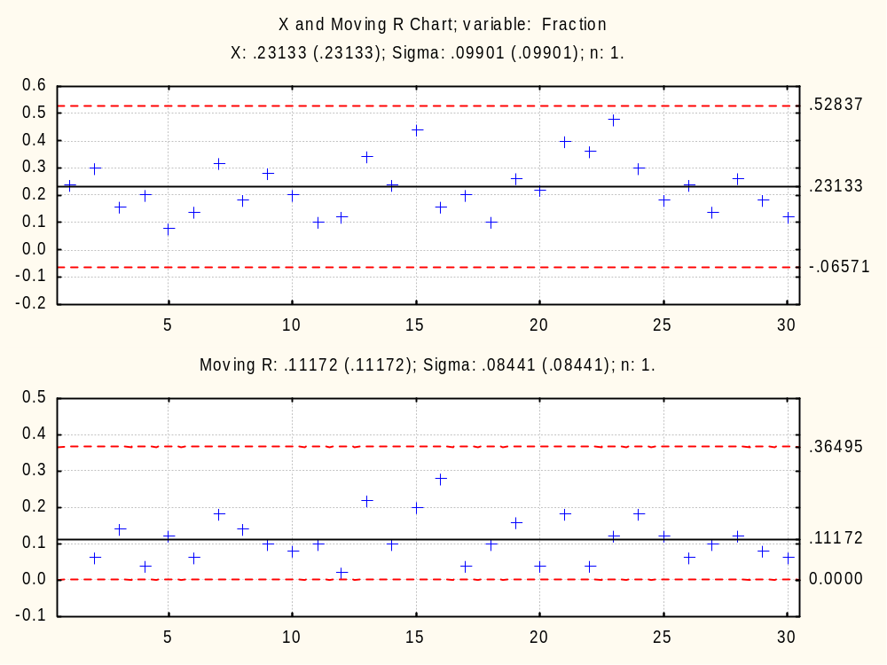
Notes:
Compare to FIGURE 10.12 p-Chart alternative example: XmR chart.
Also compare to the p Chart on Slide 26, the Np Chart on Slide 29, the C Chart on Slide 32, and the U Chart on Slide 35.

Slide 39
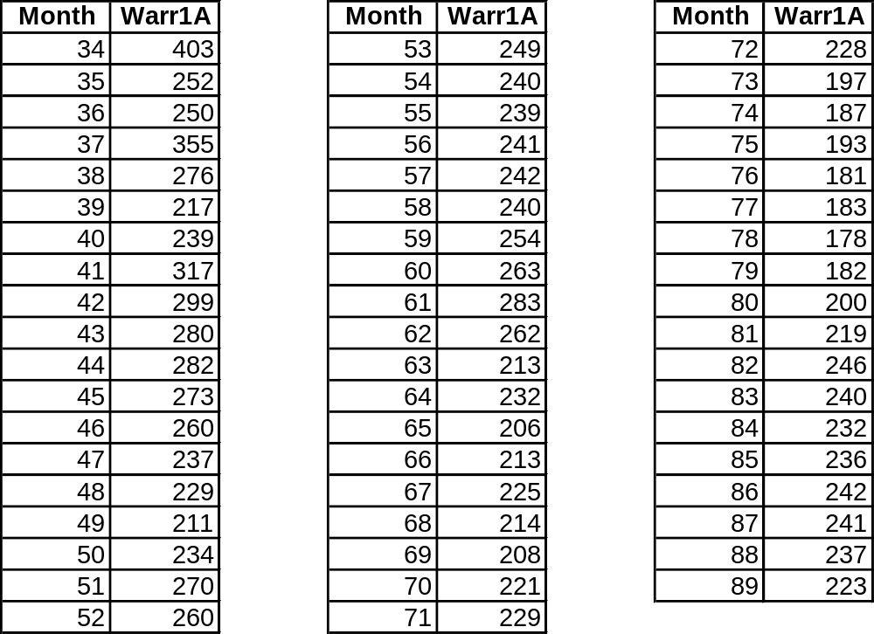
Warranty Data
Notes:
Warranty Cost data for the CFD 550H Crawler.
A 89 month study was conducted and data on warranty costs and discounts were collected over this time period. The H series 550 Crawler was introduced at Month 34 of this study.
Month = Month of the Study (1 to 89)
Warr1A = Warranty Period 1 (Basic warranty = 0 to 6 months of use) cost per machine, adjusted for inflation.

Slide 40
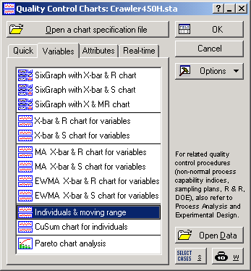
Notes:
Statistics > Industrial Statistics & Six Sigma > Quality Control Charts
Select the “Statistics” menu.
Select the “Industrial Statistics & Six Sigma” option.
Select the “Quality Control Charts” sub-option.
Select “Individuals & moving rage” on the “Variables” tab.

Slide 41
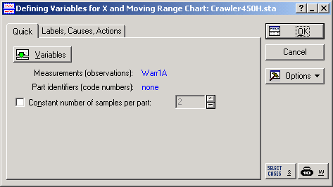
Notes:
The select the “Variables” button to specify which variable contains the data (“Warr1A”).
Then click “OK”.

Slide 42
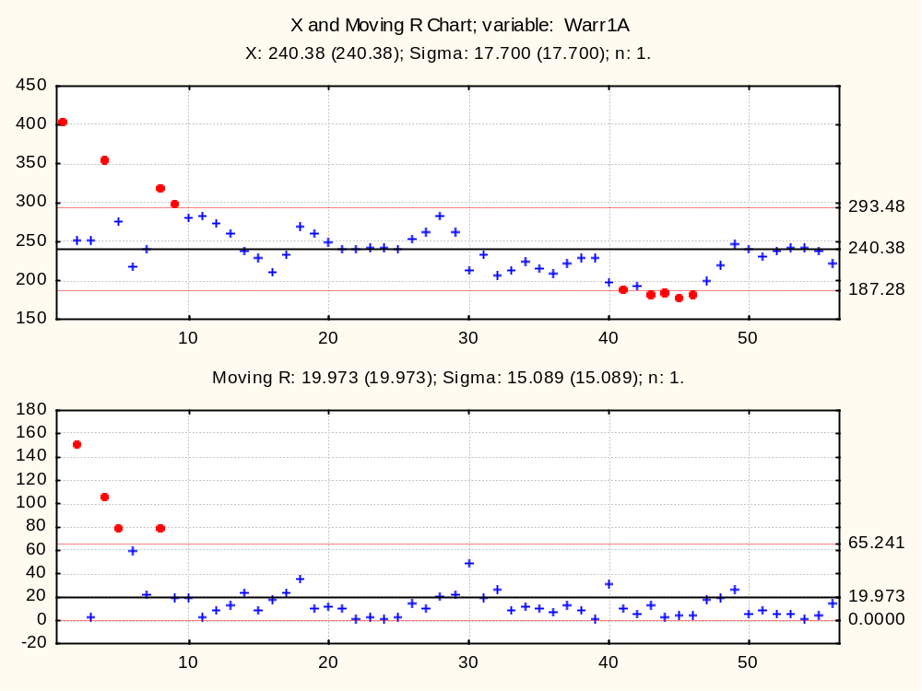
Notes:
Obviously the process that generated the data is out-of-control. The initial production had very high values and thus increase the variability in the Moving R chart, which increases the width of the upper and lower control limits on the X Chart.
Let’s see what happens if we remove the first 9 points from the calculation of the control limits.

Slide 43
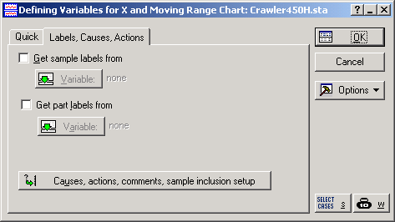
Notes:
Let’s exclude the “flyers” at the beginning of the time series.
Hit the “Cancel” button on the “X/MR” menu to return to the “Defining Variables for X and Moving Range Chart” menu.
Go to the “Labels, Causes, Actions” tab.
Select the “Causes, actions, comments, sample inclusion setup” button.

Slide 44
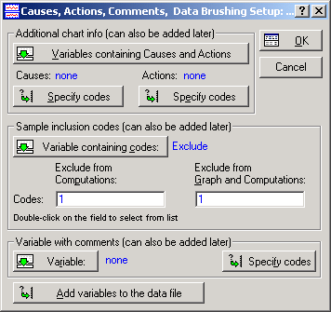
Notes:
Select the “Variable containing codes” button, select the variable named “Exclude”, and hit OK twice. (This works because I already created the “Exclude” variable for this data set, but you need to do this for your own data and restart the control chart analysis.)

Slide 45
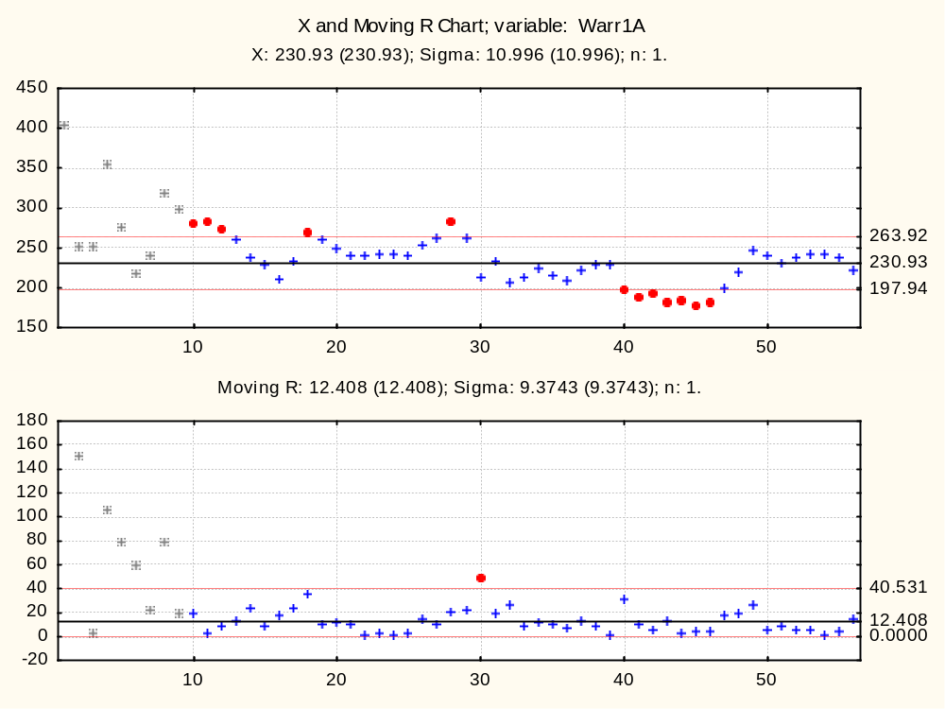
Notes:
Conclusions
The first 9 months were varying wildly – Why?
Months 10 to 16 showed a downward trend and then increased at observation 17 – Why?
Months 18 to 29 were stable and then dropped at month 30 – Why?
Months 30 to 39 were stable and then dropped at month 40 – Why?
Months 40 to 46 were stable and then increased at month 47 and stabilized at month 49 until month 56 – Why?
(The document “Applying Sets to Control Charts in STATISTICA” provides details for confirming these shifts.)
Note: It’s much easier to do this in Minitab. It’s possible that someday Statistica will have the same functionality as Minitab with respect to showing shifts and excluding outliers. I asked several years ago, but nothing happened, so I don’t expect that Statistica will change.
“It’s not the figures themselves... it’s what you do with them that matters.”

